Slide 1


Slide 2
Story behind..
Play framework

Slide 3
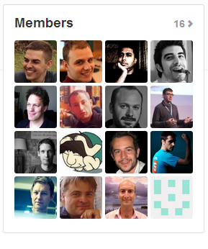

Slide 4



Slide 5


Slide 6
Plugins
And Modules

Slide 7
Plugins vs Modules
What is a plugin?
What is a module?

Slide 8
Play! Framework Plugins & Modules
In the official documentation, there is a dedicated section for plugins and modules. There is also a How-to make plugins and modules.
The link is here: Modules
Of course, any one can add his own plugins and modules ;)

Slide 9
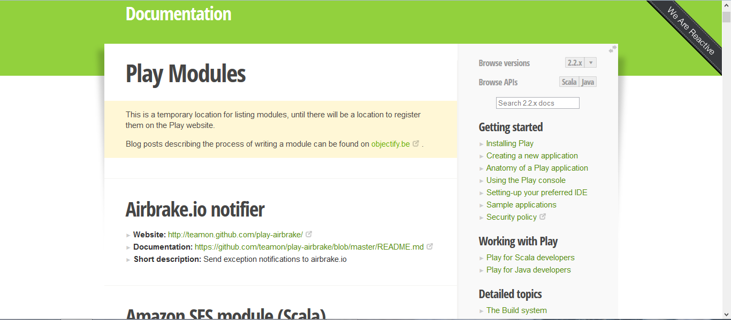
Some Examples!

Slide 10
Some Examples!
Some good plugins and modules include:

Slide 11
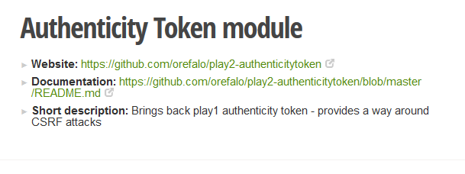
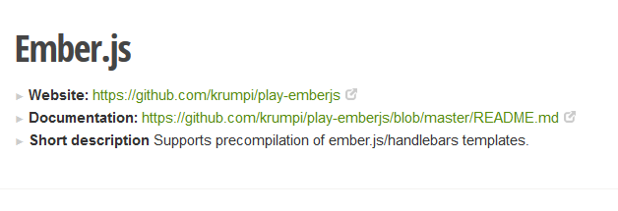
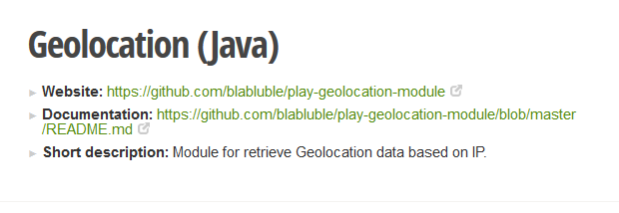
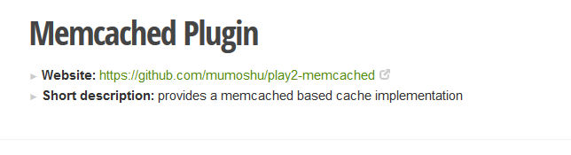
Some Examples!

Slide 12
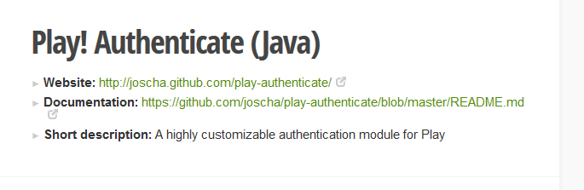
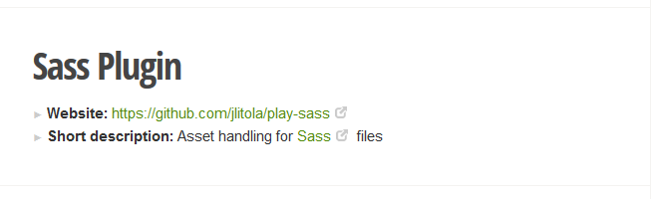
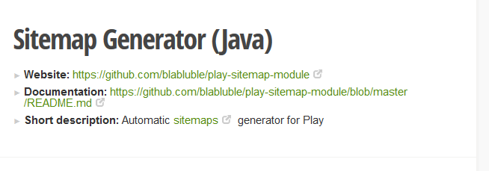
Some Examples!

Slide 13
Repo. & issues
…

Slide 14
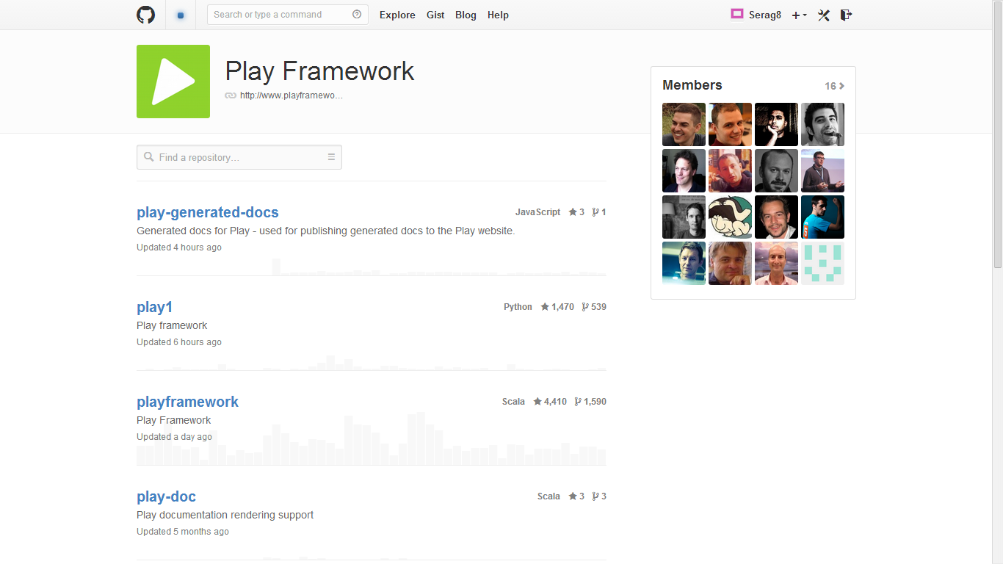
Repo.

Slide 15
Last updated
Last checked this morning 10:00 AM
Last updated then was “today at 6:04:24”
Msh msadda2een taba3an…

Slide 16

Hehehe!

Slide 17
Repository summary
Positive :
Active
Updated often
Github
Negative :
Sometimes irrelevant, check next example.

Slide 18
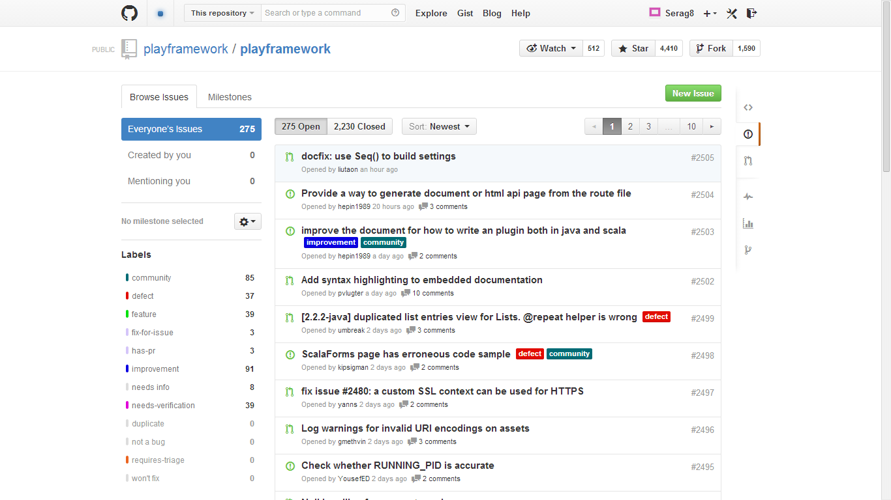
Issues :s :s

Slide 19
Issues
Total issues on github : 2,505 issues
Issues open : 275 issues
Issues closed : 2,230 issues
Issues closed on LighthouseApp : 475 issues
Newest issue : docfix: use Seq() to build settings #2505
Lastest closed issue : yesterday at 4:44:55

Slide 20
Issues Summary
Positive:
Developers Reply quickly to issues
Negative:
Issues are generic and irrelevant

Slide 21
Documentation
Official Website

Slide 22
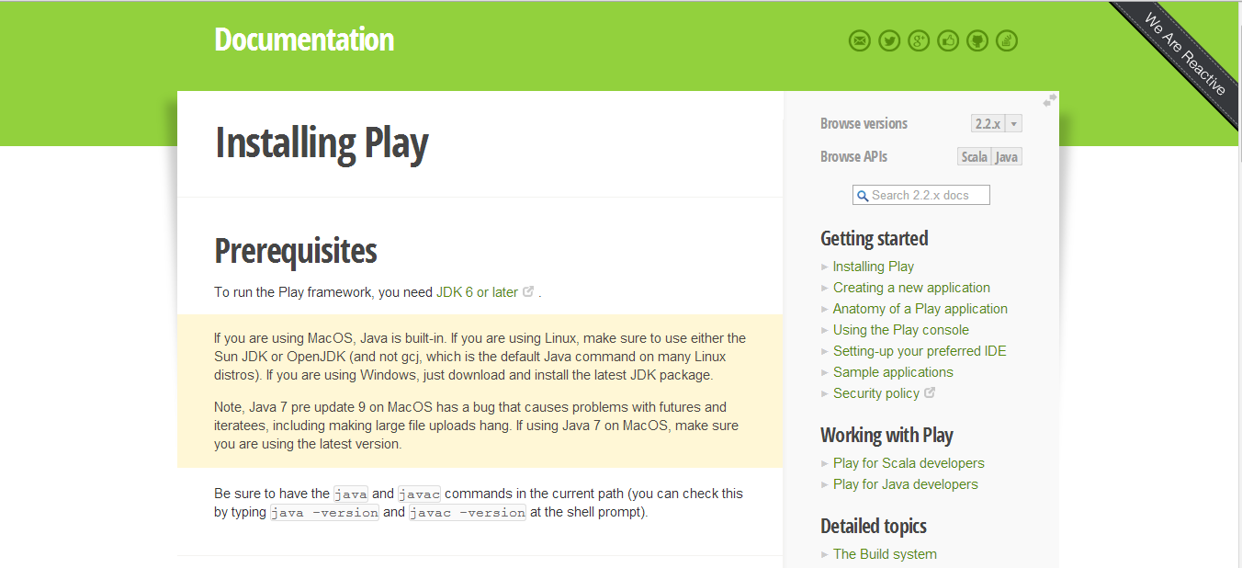
The official website of the play framework provides a detailed step-by-step guide on how to install play for first-time users. Easy to follow and apply ☺

Slide 23
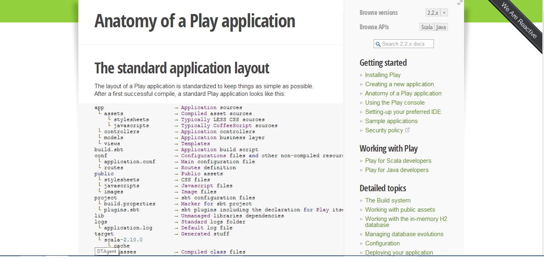
There is a good description of the components and modules in an application, to help deepen our understanding of the framework.

Slide 24
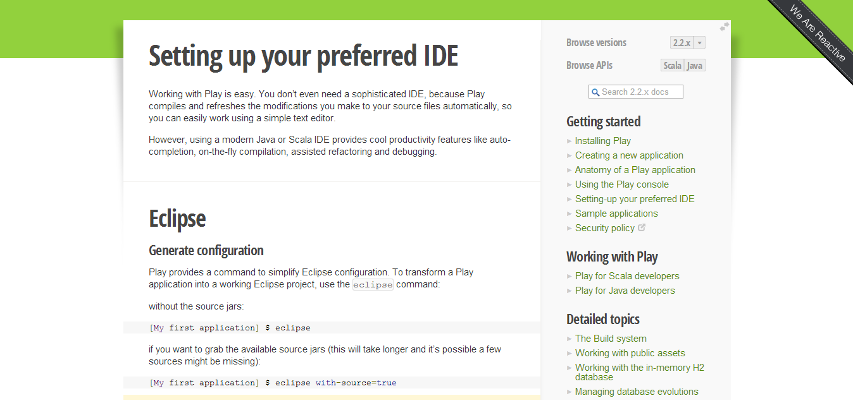
My personal favorite, thorough instructions on how our project can be configured to run on our beloved eclipse IDE

Slide 25
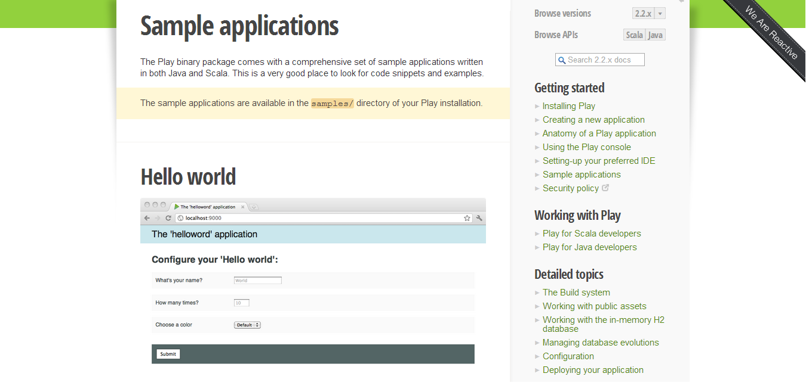
For further understanding, some diverse sample play applications and code snippets can be found in our installation directory.

Slide 26


Books
Introducing the play framework
By: Wayne Ellis
Play Framework Cookbook
By: Alexander Reelesen

Slide 27
Community
Although the play framework is relatively new, it has a very active and dynamic community.

Slide 28
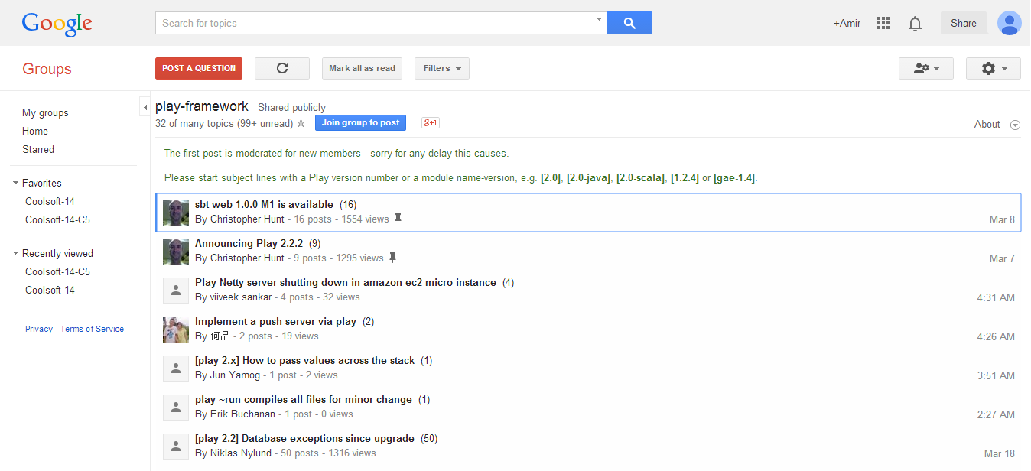
Google group: The Play Framework Google Group is the central part to the community, it is frequented by lots of people willing to help including the framework developers.

Slide 29
Pros
And Cons

Slide 30
Pros
Allows the programmer to develop faster by providing him with the ability to work on multiple projects at the same time.
Whenever the developer wants to test the changes that he has made he does not need to restart the system all he needs is to refresh the browser to seethe changes immediately.
Application testing is easy and provides accurate results.

Slide 31
Pros ‘Continued’
It has only one configuration file, most of the configurations are either default or automatically set.
The user interface is intuitive.

Slide 32
Cons
The backward compatibility feature is not available for example Play2 is not compatible with Play1 which forces the developer to do all the tasks again if he is migrating to an existing application.
There are many plug-ins but some of them are unstable.

Slide 33
Cons ‘Continued’
It’s hard to understand what is going behind the scene.
Application Startup Time Grows with Application Size

Slide 34
References

Slide 35
References:
https://groups.google.com/forum/#!forum/play-framework
http://en.wikipedia.org/wiki/Play_Framework
http://stackoverflow.com/questions/15130350/where-can-i-find-good-sources-to-learn-play-framework-and-where-is-the-developer

Slide 36
References:
http://www.objectify.be/wordpress/?p=464
http://www.playframework.com/documentation/2.2.x/Modules
http://www.playframework.com/documentation/2.2.x/Home
http://www.oracle.com/technetwork/java/javaee/overview/index.html

